Slide 1


24-HOUR FORECAST
24-10-2022 @ 1200 UTC
Department of Meteorology and Climate Science,
KNUST

Slide 2
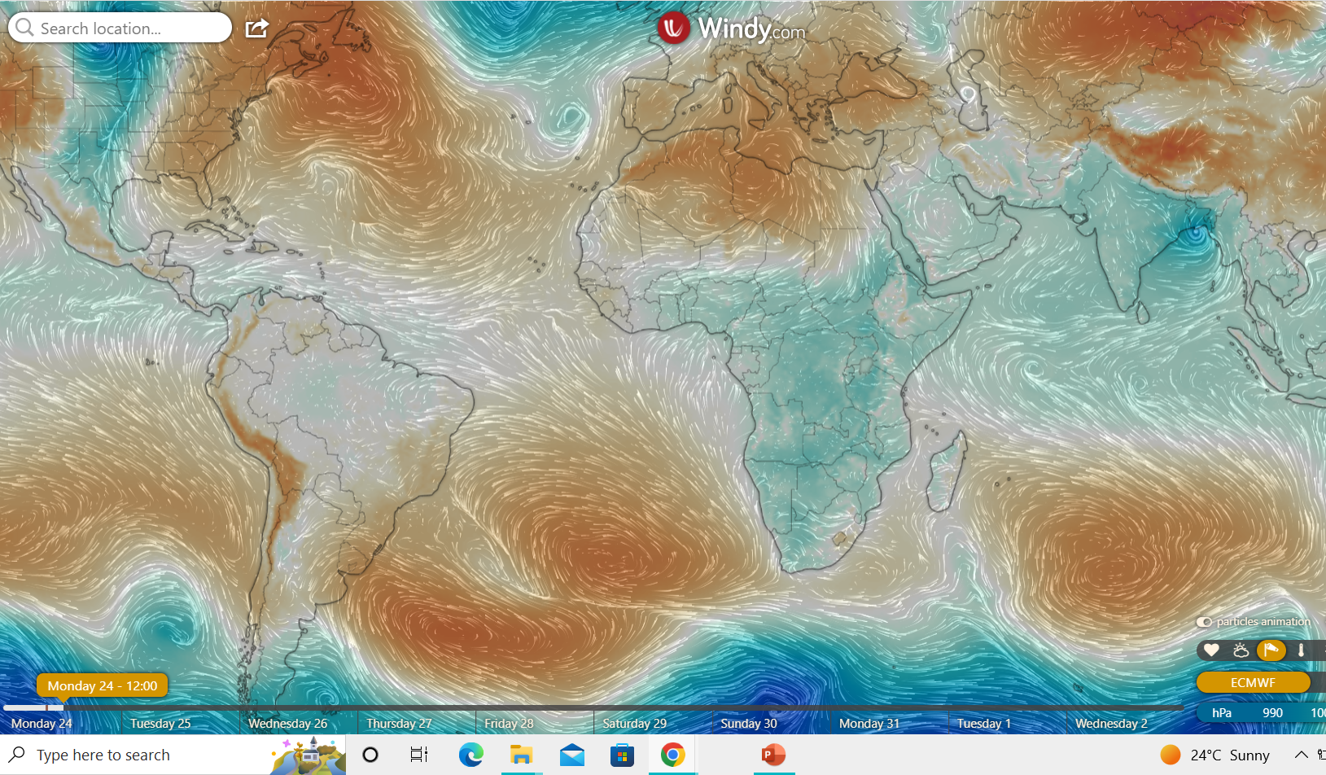
PRESSURE SYSTEMS @1200
1017hPa
1027hPa

Slide 3
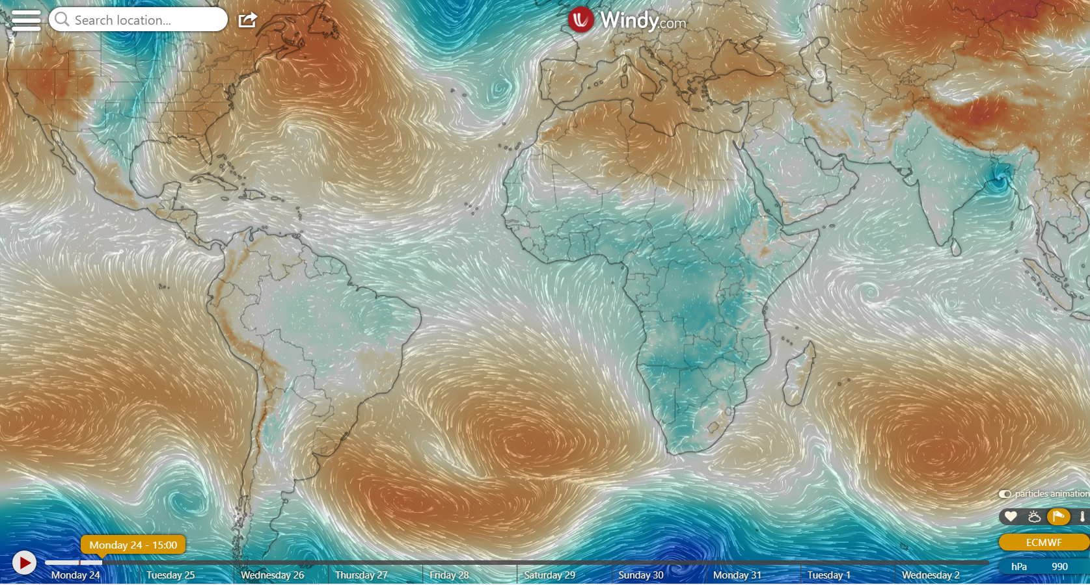
@ 1500
1015hPa
1026hPa

Slide 4
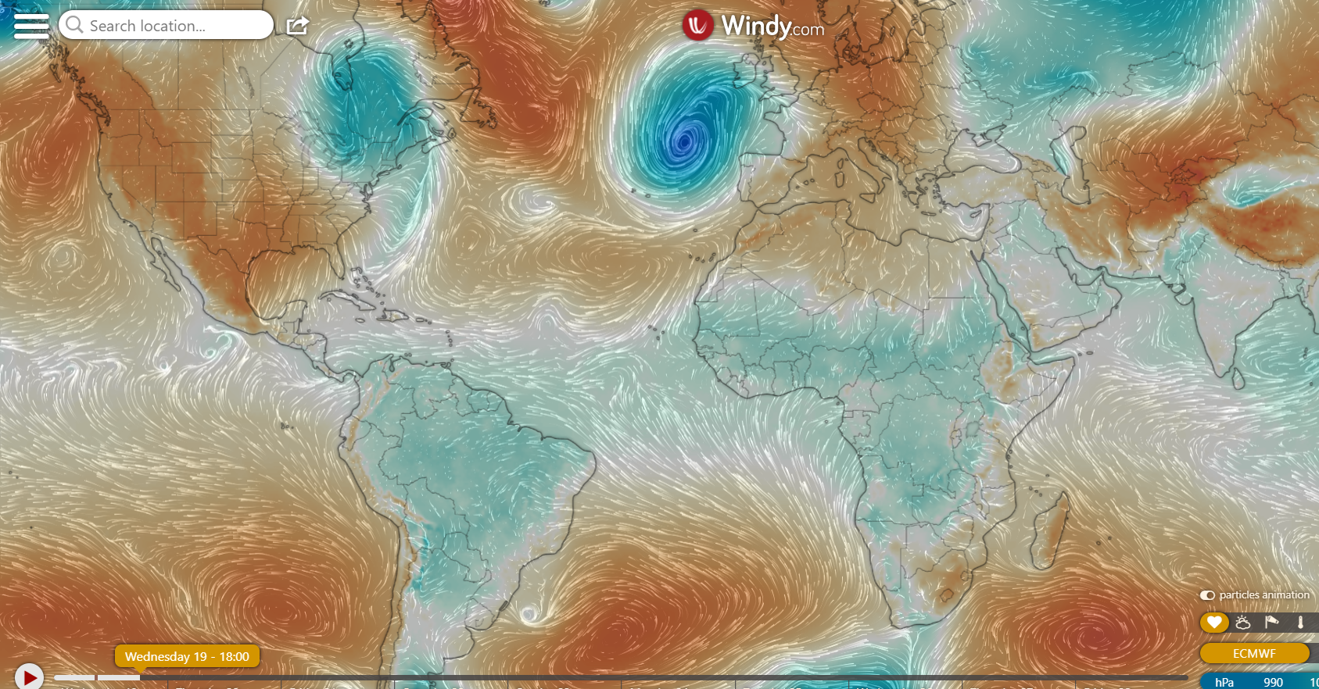
@1800
1015hPa
1031hPa

Slide 5
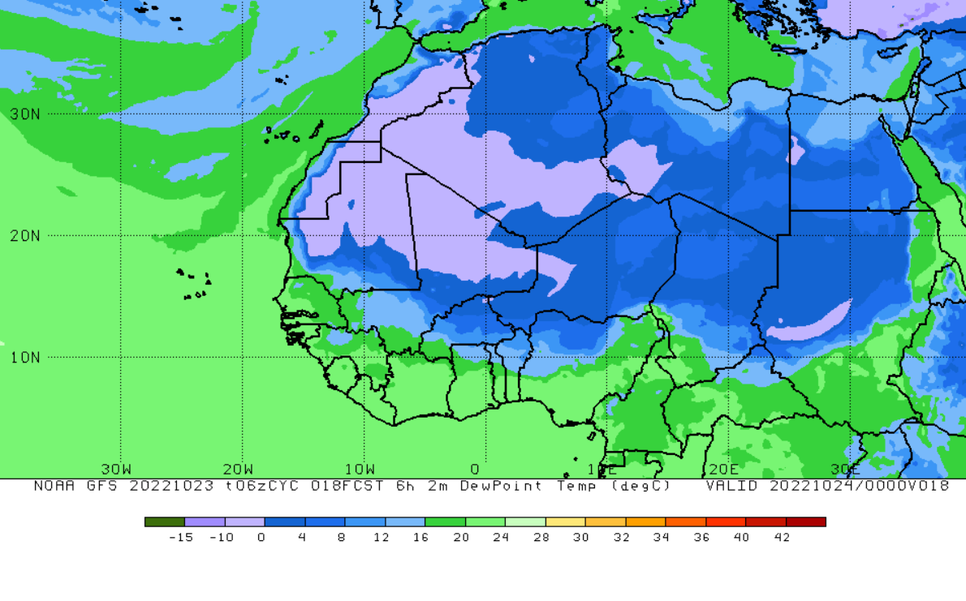
ITD POSITION
@ 0000
9.9N

Slide 6
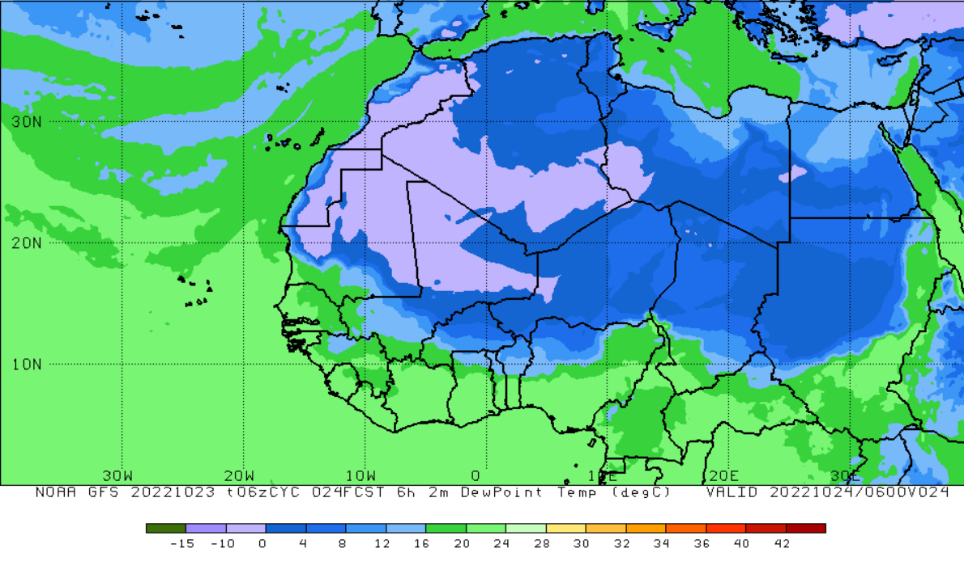
@ 0600
9.9N

Slide 7
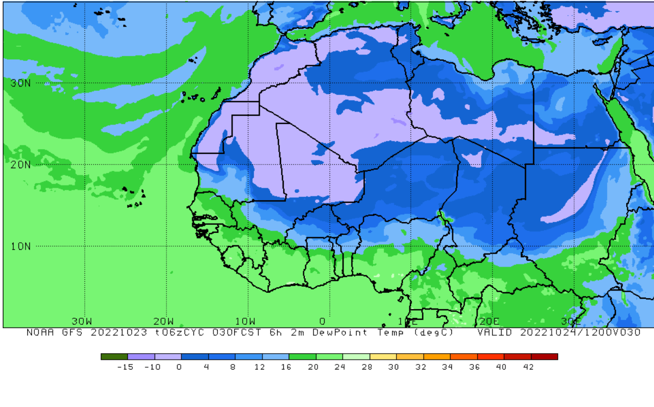
@ 1200
9.9N

Slide 8
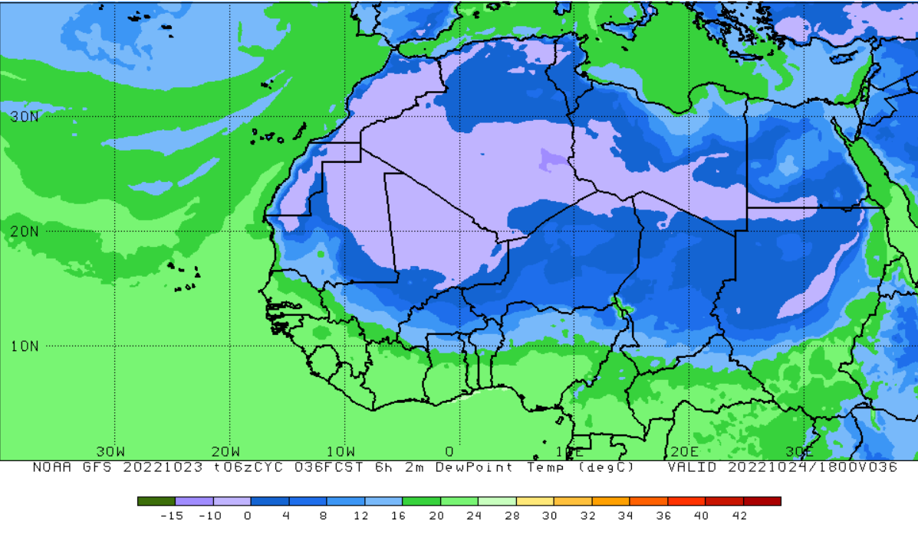
@ 1800
9.8N

Slide 9
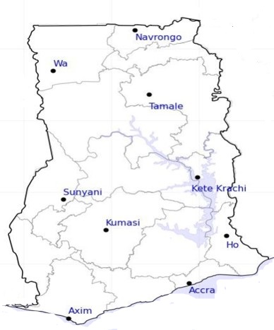

50%
24-HOUR FORECAST
24-10-2022 @ 1200 UTC
55%
RH AT DAY
61%
58%
74%
79%
77%
80%
81%
85%

Slide 10
54%
24-HOUR FORECAST
24-10-2022 @ 1200 UTC
63%
RH AT NIGHT
72%
70%
83%
95%
93%
98%
88%
87%

Slide 11
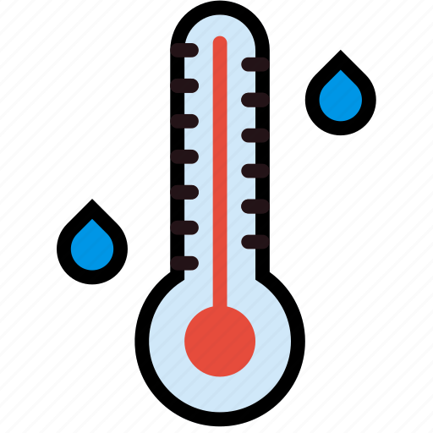
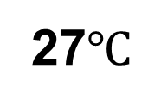
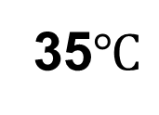
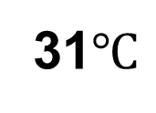
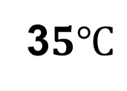
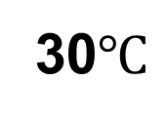
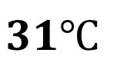
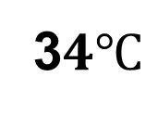
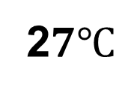
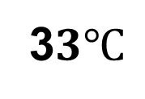
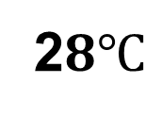
35$℃$
24-HOUR FORECAST
24-10-2022 @ 1200 UTC
3$3℃$
TEMPERATURE AT DAY
3$4℃$
3$5℃$
31$℃$
30$℃$
$$31℃$$
27$℃$
2$8℃$
2$7℃$

Slide 12
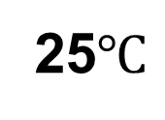
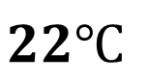
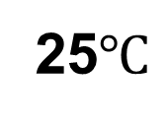
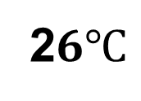
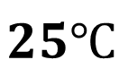
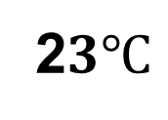
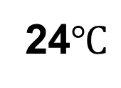
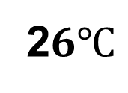
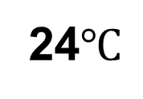
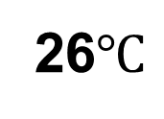
25$℃$
24-HOUR FORECAST
24-10-2022 @ 1200 UTC
24$℃$
TEMPERATURE AT NIGHT
25$℃$
$$25℃$$
2$6℃$
2$3℃$
24$℃$
$$22℃$$
26$℃$
2$6℃$

Slide 13
GENERAL OUTLOOK
24-HOUR FORECAST
24-10-2022 @ 1200 UTC
PROBABILITY OF RAINS
0%

Slide 14


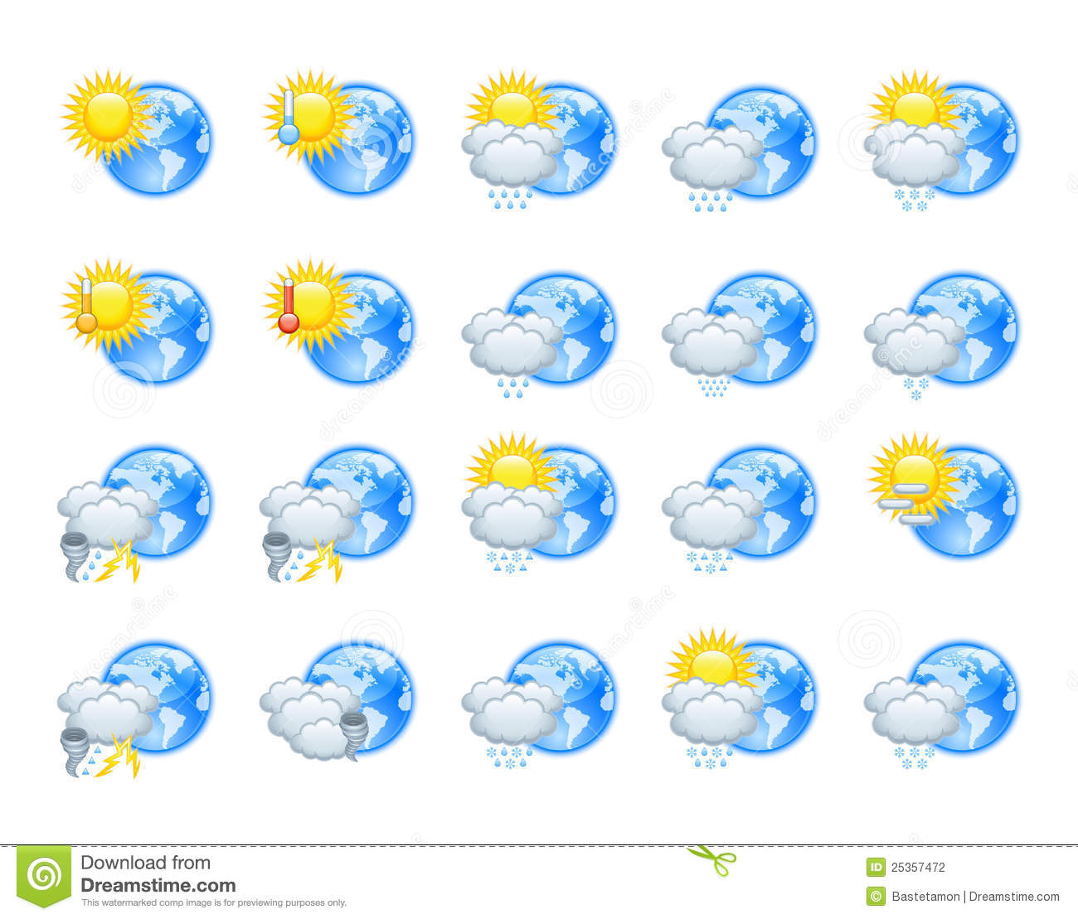


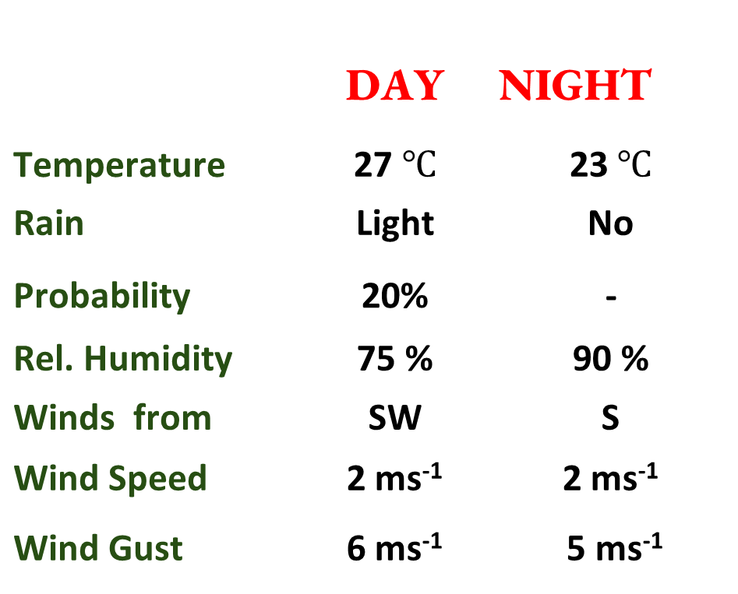




Meteorology and Climate Science
Department of Physics, KNUST
24-HOUR FORECAST
24-10-2022 @ 1200 UTC
Forecast Summary (KUMASI)
Rain
Wind
Dust
 | DAY | NIGHT
Temperature | 27 $℃$ | 22$℃$
Rain | Light | No
Probability | - | -
Rel. Humidity | 84 % | 98 %
Winds from | SW | SW
Wind Speed | 2 ms⁻¹ | 2 ms⁻¹
Wind Gust | 5 ms⁻¹ | 4 ms⁻¹
Low risk
Be aware
Be Prepared
Take Action
SUNSET: 05:49 PM SUNRISE: 05:54 AM

Slide 15


